Slide 1

Ministry for Ecological Transition
General Commission for Sustainable Development
Research and innovation department
Ecolab

Slide 2

Launch of the Call
for Expressions of Interest (CEI) ‘Greentech Innovation’ 2026
OPEN TO European Union STARTUPS AND SMEs

Slide 3
Greentech Innovation
A support program for start-ups and SMEs
innovating in the field of public policies
for ecological transition

Slide 4

The ‘Greentech Innovation’ program is run by Ecolab
The Greentech Innovation Program:
Ecolab, an innovation lab for:
boosting the French (and European) Greentech ecosystem
transforming administration and public policies on ecological transition and land use planning through data, artificial intelligence, and knowledge.
Ecolab, a structure:
within the Research and Innovation Department
of the General Commission for Sustainable Development
of the Ministries of Ecological Transition, Spatial Planning, Transport, Cities, and Housing

Slide 5
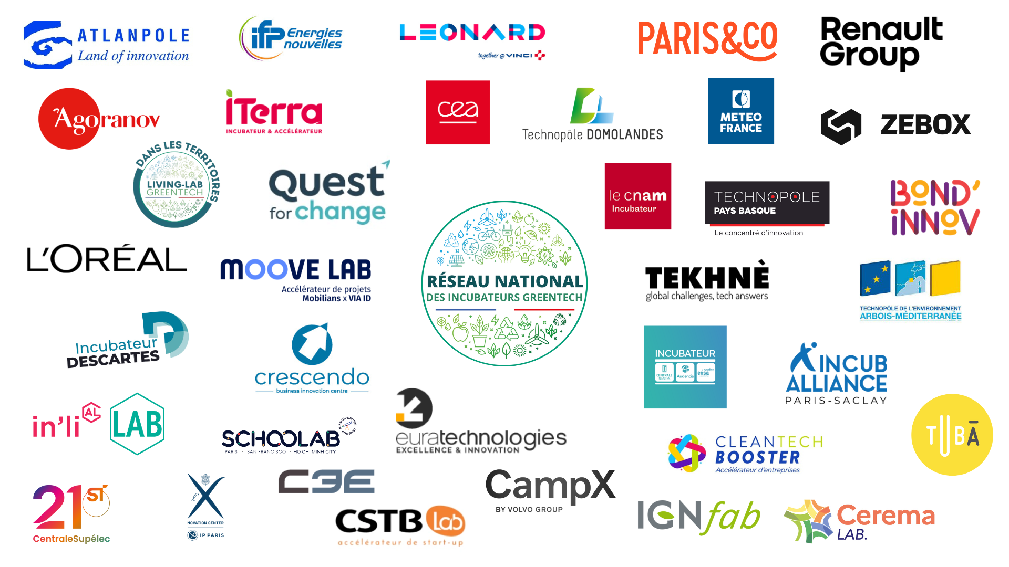
Boosting the French ecosystem of Greentech incubators
The Greentech Innovation Program:
The Greentech incubators network
A network to enrich relationships between public and private incubators that support innovators in the ecological transition

Slide 6
Boosting the French and European Greentech Start-up Ecosystem
The Greentech Innovation Program:
2,800 Greentech start-ups listed in France at the end of 2023, according to the public investment bank (BpiFrance) ‘s annual study (estimated ≈ 3,100 right now)
A community of 297 active start-ups and SMEs whose innovative solutions have been officialy recognized as “Greentech Innovation” after the annual selection processed by experts from the Ministries of Territorial Development and Ecological Transition and their partners (= Call for Expressions of Interest (CEI) ‘Greentech Innovation’ ).
Objective: Accelerate public policies for ecological transition through trusted business innovation

Slide 7
A dedicated Support Program for companies recognized as ‘Greentech Innovation’ Implemented by Ecolab
The Greentech Innovation Program:
VISIBILITY
BOOSTER
SALES & NETWORKING BOOSTER
DIGITAL BOOSTER
PUBLIC PROCUREMENT BOOSTER

Slide 8
Visibility Booster
List of awarded companies announced by the Minister and relayed by press kit (≈ June)
Display of the Greentech Innovation distinction logo (proof of government support)
Promotion through various communication channels (social media, newsletter, interviews, …)
Registration and presentation in the ‘Greentech Innovation’ directory of eco-innovative start-ups and SMEs (in print and on-line)
Close contact to French ministries and government agencies
Participation at the annual Meet’Up Greentech (≈ October / November)
Participation at business forums (stands, pitches, contributions)

Slide 9
Sales and Networking Booster
Professional events dedicated to business development (themed business meetings, networking, etc.)
Investor pitch sessions
Access to the directory of impact investors
A hub for sharing ideas (access to Ecolab’s ‘Greentech Innovation’ Community Slack space, etc.)

Slide 10
Digital Booster
Webinars on topics related to innovation, ecological transition, economic development, etc.
Access to the Greentech Innovation Job Board
Access to a media/press contact database
Access to strategic and commercial documents (market research, market analysis)

Slide 11
Public Procurement Booster
Training/awareness-raising on French public procurement (legislation, innovative contracts, etc.)
Sharing of calls for projects related to public procurement
Networking with buyers committed to sustainable procurement (regional networks, local authorities, universities, etc.)
Access to Cision, a database of institutional contacts
Participation in major events related to public procurement (Greentech decision-makers meetings, GeoDataDays, etc.)

Slide 12
How to be distinguished in the ‘Greentech Innovation’ CEI ?
The annual ‘Greentech Innovation’ award selects 25 to 30 solutions developed by French and European start-ups and SMEs based on ambitious, innovative and sustainable processes, products or services (or a combination thereof).
The solutions may be high-tech, low-tech, technological or non-technological.
The ‘Greentech Innovation’ award does not include any financial support.

Slide 13
How to be distinguished in the ‘Greentech Innovation’ CEI ?
Conditions for applying for the 2026 Greentech Innovation CEI
The applicant company must be a small and medium-sized enterprise (SME) complying with the European Union definition*. Consortia are not permitted.
It must be resident in the European Union.**
The solution must have reached at least the ‘minimum viable product’ stage.
The solution must fall within one of the 12 key sectors of the ecological transition.
The application must be complete and submitted by the deadline on the Démarches Simplifiées (meaning ‘Simplified Procedures’) French governmental on-line platform (open from 24 November 2025 to 19 January 2026).
Please note: Companies may apply multiple times to the CEI.
* SME = fewer than 250 employees; sales of less than €50 million; independent (no more than 25% of the company, or of the voting rights, are owned by an enterprise, or jointly by several enterprises, that do not fall within to the definition of SME)
** Companies domiciled in France and companies domiciled in the UE have to fill out 2 different digital application forms (SAME questions)

Slide 14
How to be distinguished in the ‘Greentech Innovation’ CEI ?
The 12 key sectors of the ecological transition
Sustainable food and farming
Sustainable buildings and cities
Decarbonising industry
Water, biodiversity and biomimicry
Circular economy
Renewable and low-carbon energy
Maritime innovation and marine ecosystems
Sustainable mobility
Risk prevention
Environmental Health – One Health
Green IT*
Sustainable finance & CSR
* Green IT refers to innovations that aim to reduce the ecological footprint of information and communication technologies. Those that aim to use digital technology, even low-impact technology, as a lever and not a direct goal have to fit in another key sector.

Slide 15
How to be distinguished in the ‘Greentech Innovation’ CEI ?
Minimum viable product
A minimalist but deliverable and functional version of a process, product, or service (or combination thereof).
Must at least partially meet the initial ambition of the product and the theoretical objective of the finished product.
Must demonstrate technical stability and announce an upcoming version that will address its flaws and add new features.
Must be suitable for testing in real-world situations through technical and user testing.
May or may not already be on the market.
The demonstration may be based on criteria such as: solution deployment date, number of customer tests performed, number of customers using the solution, user quality feedback, etc.

Slide 16
How to be distinguished in the ‘Greentech Innovation’ CEI ?
Solutions are analyzed according to the following non-hierarchical criteria:
Maturity of the solution
Adequacy of the solution in line with public policies on ecological transition and their priorities
Potential contribution of the solution to ecological transition
Eco-design approach of the solution
Innovative nature of the solution
Economic and value creation potential of the solution
Adequacy of the solution for the market
Capacity of the company to develop the solution.

Slide 17
How to be distinguished in the ‘Greentech Innovation’ CEI ?
Process
1/ Eligibility check, review of applications, preliminary ranking
2/ Auditions for certain candidates (April)
10-minute presentation
10 minutes of questions and answers
Standard outline provided one to two weeks in advance
3/ 25 to 30 winners (June)
(list subject to ministerial approval)
Jury (1 per key sector)
A member of Ecolab
Ministry experts
Bpifrance
ADEME
qualified experts (members of the Greentech incubator network, competitiveness clusters, etc.)
Respect the confidentiality of the information transmitted by the applicant companies

Slide 18
How to be distinguished in the ‘Greentech Innovation’ CEI ?
Our advice/what we expect from applicant companies
Pay close attention to the quality of each response and attached document, as all criteria are taken into consideration by the judging panels
Prepare for the oral presentation: 10 minutes + 10 minutes is short, so your presentation must be effective. Do not simply repeat the information in your application file; if possible, add new elements (e.g., new customers, details on the financing plan, technical difficulties overcome, etc.).
Reaching the “minimum viable product” stage is essential and will be closely scrutinized.
Qualify the innovation, especially if it is not technological.
Show that the environmental impacts of the solution have been thoroughly analyzed.
Provide details and figures, quantitative data (if available), particularly on the environmental aspect.

Slide 19
What is expected of the winning companies
display the Greentech Innovation logo in their communication materials
respond to requests from Ecolab within the deadlines specified in those requests (creation and annual updating of the directory listing, satisfaction questionnaires, etc.)
be present at events announcing the list of winning solutions (usually in June) unless there is a compelling, justified reason, announced as early as possible
be present to exhibit at a stand at the Greentech Meet'Up in the year their solution is selected as a winner (usually in October) unless there is a compelling, justified reason, announced as early as possible
honor commitments to attend events to which it is invited and which it has accepted
relay Ecolab's communications as much as possible on any initiative related to Greentech support
notify Ecolab as soon as possible in the event of a significant change to the solution, takeover, or liquidation of the company. In the event of a takeover, communicate the name of the acquiring company.
Withdrawal of the “Greentech Innovation” distinction may be decided unilaterally in the event of non-compliance with these commitments.

Slide 20
CEI 2026 Calendar
Application phase:
November 24, 2025 to January 19, 2026 (4:00 p.m.)
Auditions:
April 2026 (indicative: April 13, 2026 to April 24, 2026)
Announcement of the list of winning companies:
June 2026 (at Viva Technology Exhibition Edition 2026 17-20 June 2026 ?)
Meet’Up Greentech 2026
October or November 2026

Slide 21
Documentation and Contacts
The Ecolab website: https://greentechinnovation.fr/appel-a-manifestation-dinteret/
Where you will find:
The rules for the 2026 ‘Greentech Innovation’ CEI
Links to the application forms on Démarches Simplifiées (from 24 November 2025)
An FAQ
Replay and presentation support of the webinars inaugurating the 2026 CEI
Contact: greentechinnovation@developpement-durable.gouv.fr

Slide 22
Questions/Answers

